Slide 1
Amazecare hospital management system
By
charuhasini K

Slide 2
Agenda:
Application overview
Spring eureka
Swagger ui
Controllers and its operations
Database schema

Slide 3
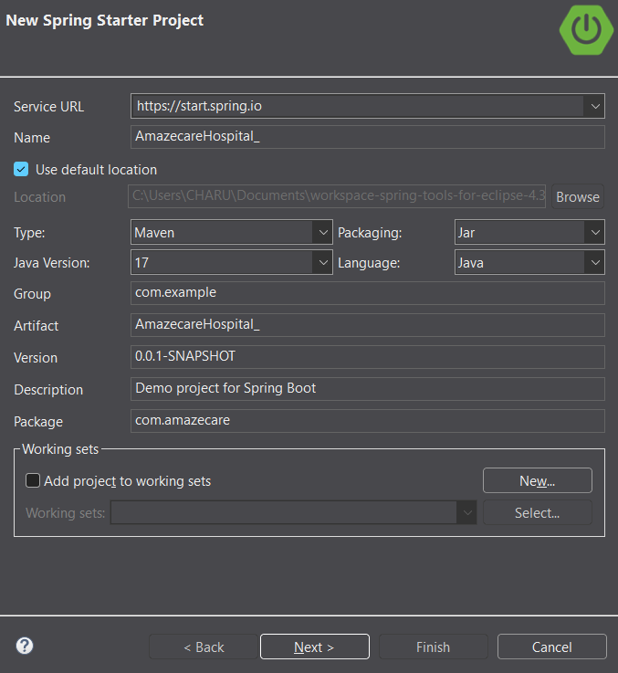
Application overview:
Project name: AmazecareHospital
Backend languages: Java, Spring Boot
Package: com.amazecare
Type: Maven

Slide 4
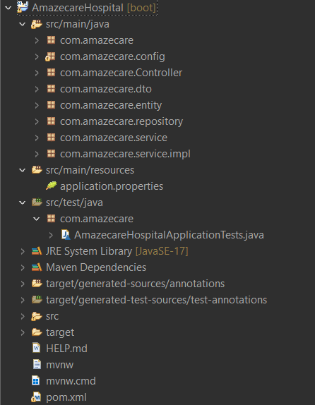
Application structure:
Packages under src/main/java
com.amazecare
com.amazecare.config
com.amazecare.controller
com.amazecare.dto
com.amazecare.entity
com.amazecare.repository
com.amazecare.service
com.amazecare.service.impl

Slide 5
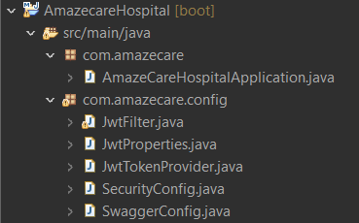
Classes in
com.amazecare and com.amazecare.config
com.amazecare contains a class called AmazeCareHospitalApplication.java which act as the main class of the application.
com.amazecare.config contains 5 configuration classes such as:
JwtFilter.java
JwtProperties.java
JwtTokenProvider.java
SecurityConfig.java
SwaggerConfig.java

Slide 6
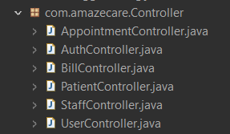
Classes in
com.amazecare.controller
com.amazecare.controller contains 6 controller classes such as:
AppointmentController.java
AuthController.java
BillController.java
PatientController.java
StaffController.java
UserController.java

Slide 7
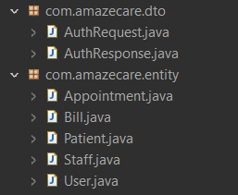
Classes in
com.amazecare.dto and com.amazecare.entity
com.amazecare.dto contains 2 classes called AuthRequest.java and AuthResponse.java.
com.amazecare.entity contains 5 configuration classes such as:
Appointment.java
Bill.java
Patient.java
Staff.java
User.java

Slide 8
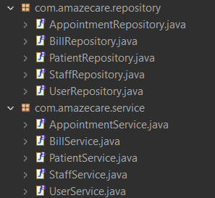
Classes in
com.amazecare.repository and com.amazecare.service
com.amazecare.repository contains 5 classes such as :
AppointmentRepository.java
BillRepository.java
PatientRepository.java
StaffRepository.java
UserRepository.java
com.amazecare.service contains 5 configuration classes such as:
AppointmentService.java
BillService.java
PatientService.java
StaffService.java
UserService.java

Slide 9
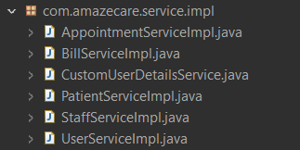
Classes in
com.amazecare.service.impl
com.amazecare.controller contains 6 controller classes such as:
AppointmentServiceImpl.java
BillServiceImpl.java
CustomUserDetailsService.java
PatientServiceImpl.java
StaffServiceImpl.java
UserServiceImpl.java

Slide 10
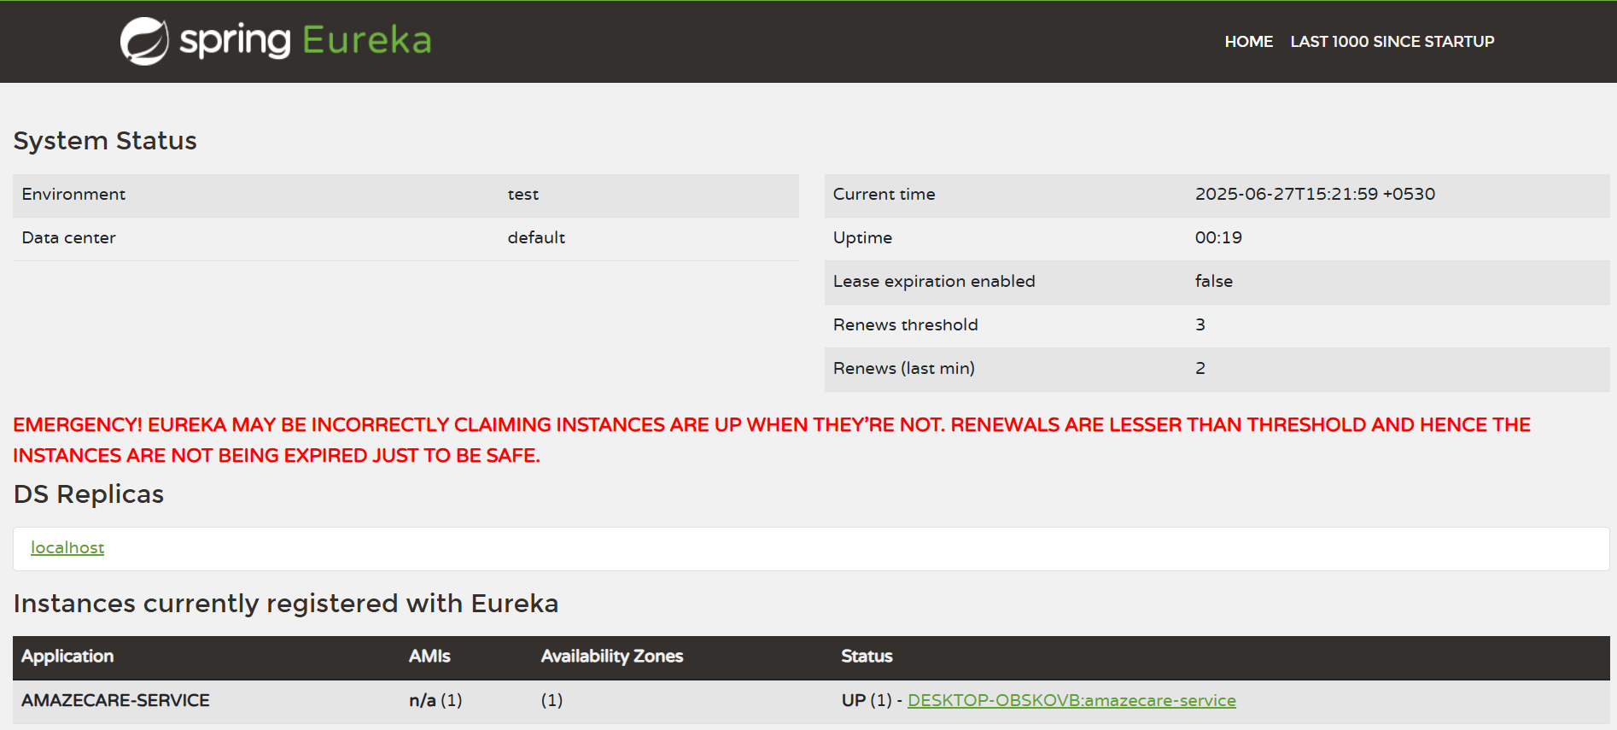
Once the Application is executed successfully it is registered in the eureka server.

Slide 11
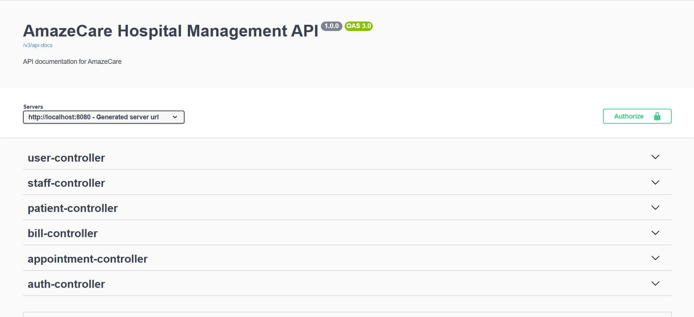
Further, the application is opened in the swagger API for backend CRUD operations.

Slide 12
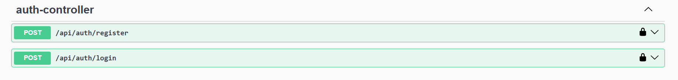
Auth Controller has only the post operation, as it act as the LOGIN and SIGNUP process for the application.

Slide 13
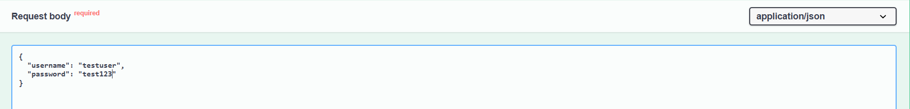
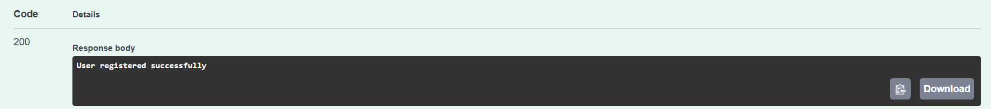
SIGNUP PROCESS
Username and password is provided to the user through the /api/auth/register
Once the data is added , user gets a response as user added successfully.

Slide 14
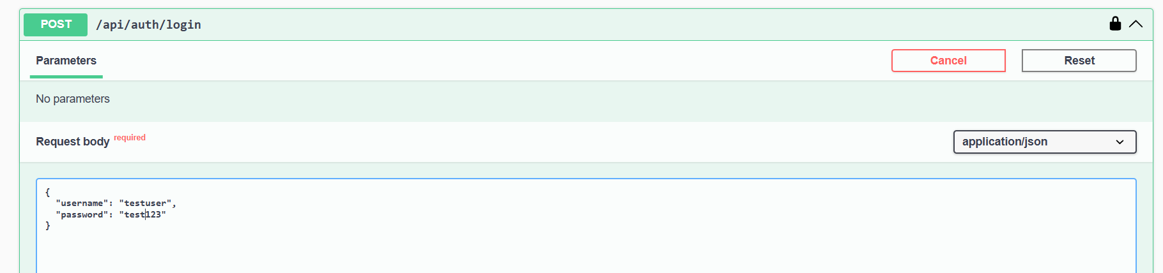
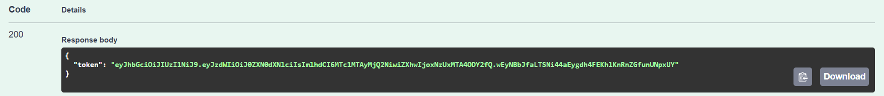
LOGIN PROCESS
Username and password is provided to the user through the /api/auth/login
Once the data provided matches , user gets the access token.

Slide 15
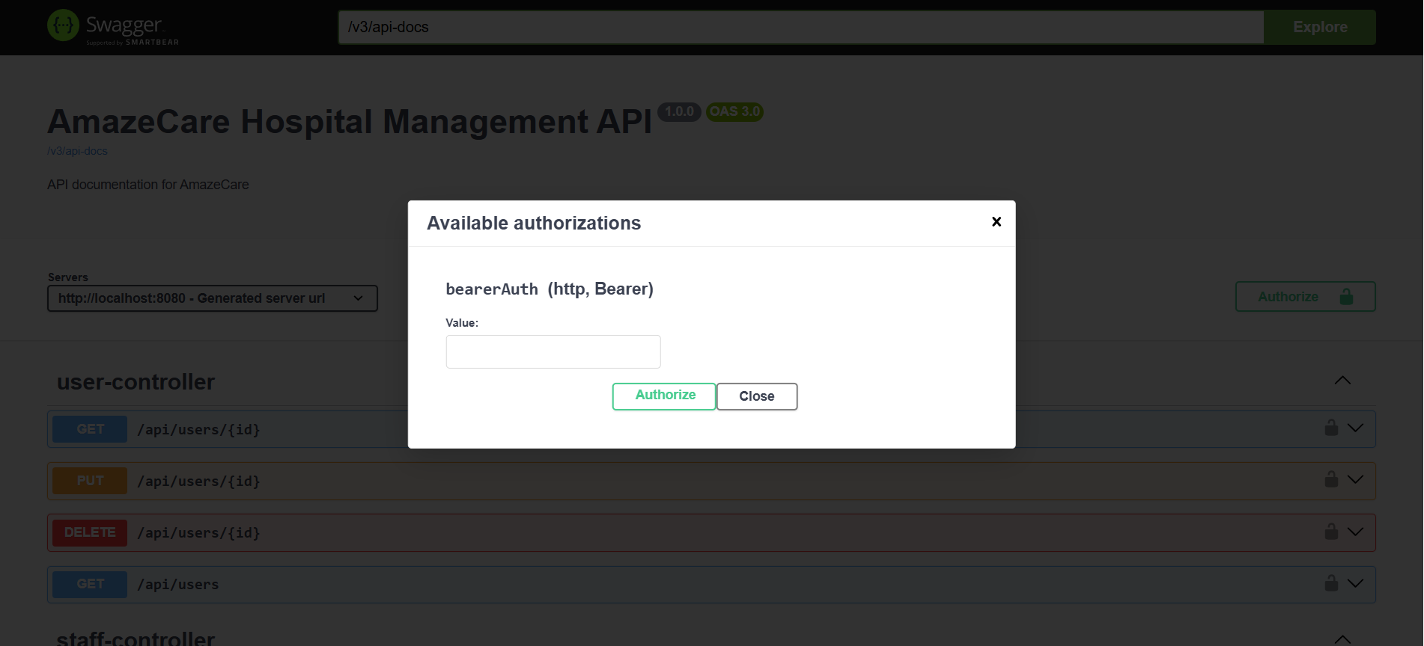
Users are asked to enter the token as the authorization value to get the access to other operations.

Slide 16
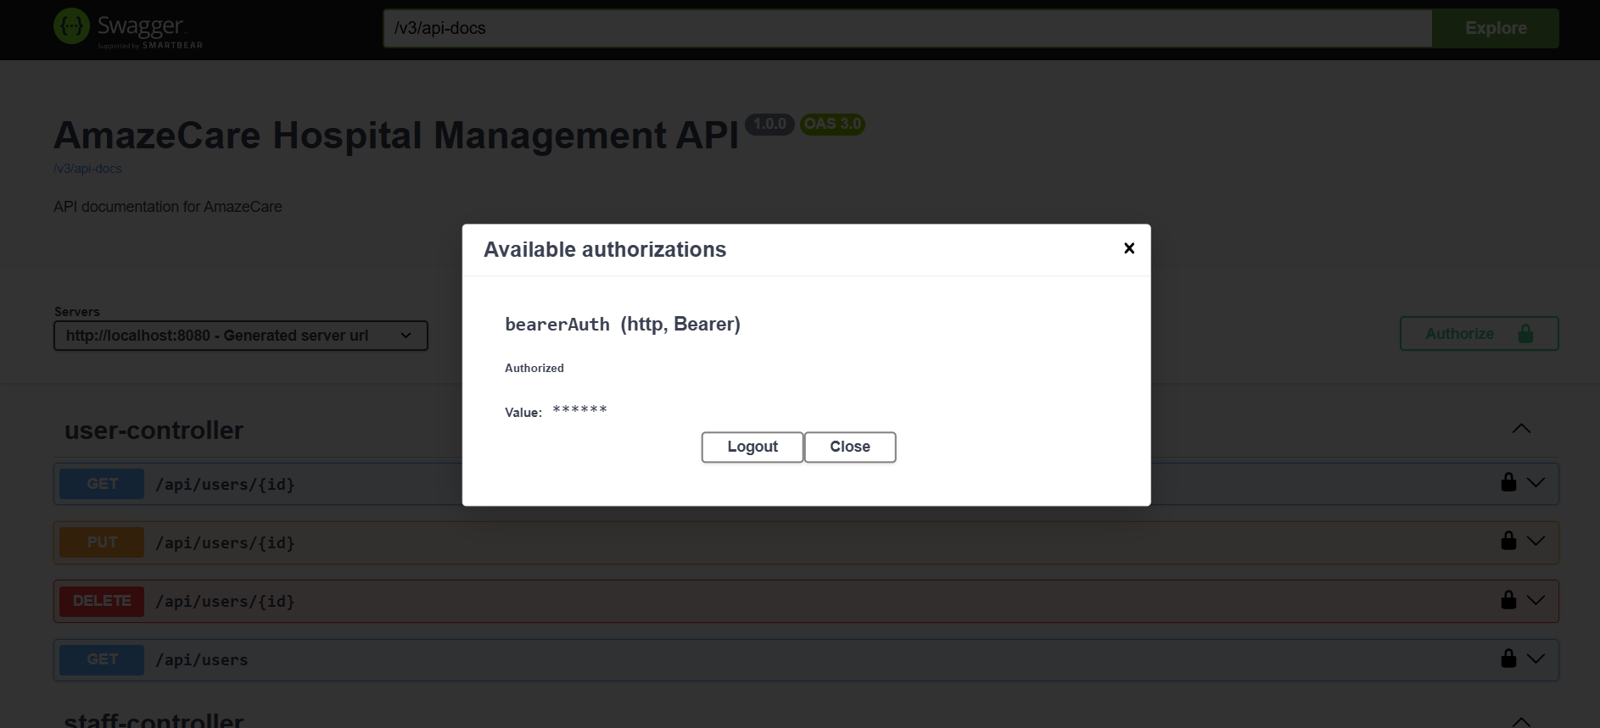
The Users are given access once the token is validated.

Slide 17
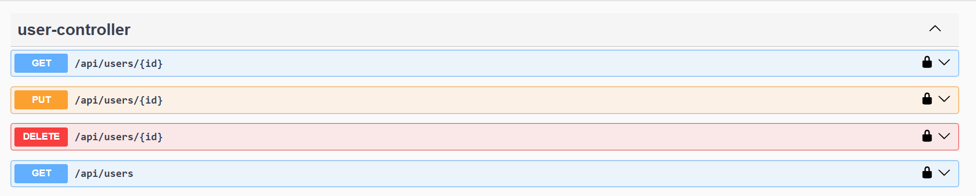
User Controller performs the operations like
Get- To get the user data with respect to id number.
Put-To update the user data with respect to id number.
Delete-remove the user data with respect to id number.
Get-To get all the user data in the database.

Slide 18
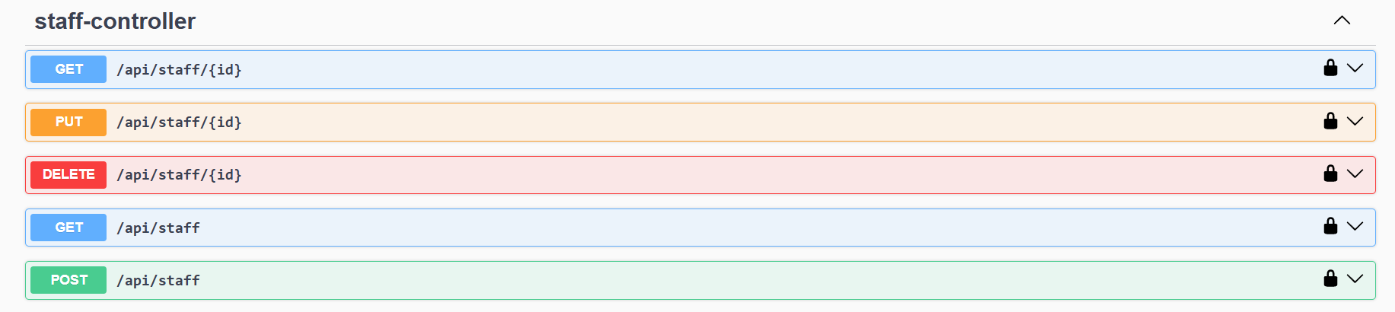
Staff Controller performs the operations like
Get- To get the staff data with respect to id number.
Put-To update the staff data with respect to id number.
Delete-remove the staff data with respect to id number.
Get-To get all the staff data in the database.
Post-To insert the data of new staff.

Slide 19
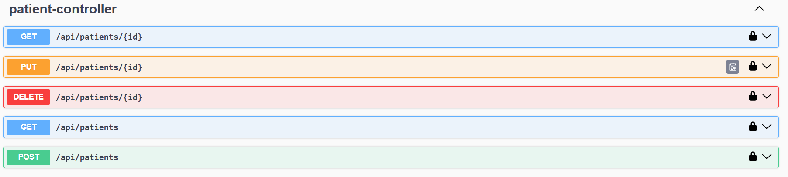
Patient Controller performs the operations like
Get- To get the patient data with respect to id number.
Put-To update the patient data with respect to id number.
Delete-remove the patient data with respect to id number.
Get-To get all the patient data in the database.
Post-To insert the data of new patient.

Slide 20
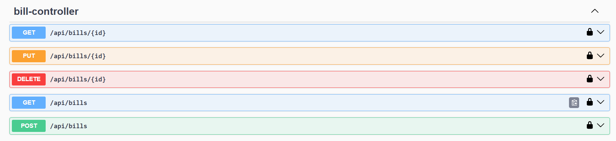
Bill Controller performs the operations like
Get- To get the billing amount of the patient with respect to id number.
Put-To update the billing amount of the patient with respect to id number.
Delete-remove the billing amount of the patient with respect to id number.
Get-To get all the billing amount of the patients in the database.
Post-To insert the billing amount of new patients.

Slide 21
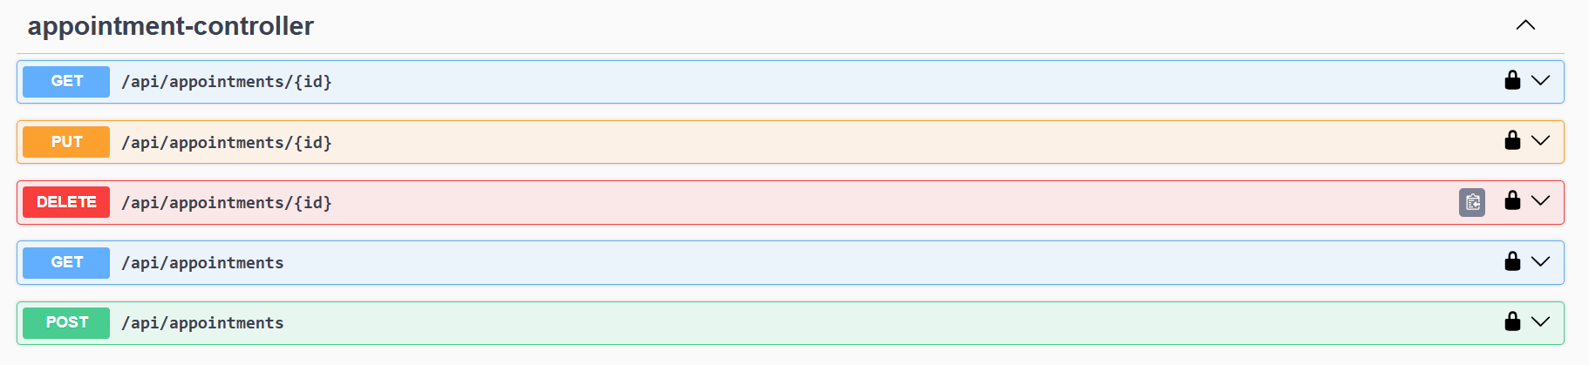
Appointment Controller performs the operations like
Get- To get the appointment details with respect to id number.
Put-To update the appointment details with respect to id number.
Delete-remove the appointment details with respect to id number.
Get-To get all the appointment details in the database.
Post-To insert new appointment details .

Slide 22
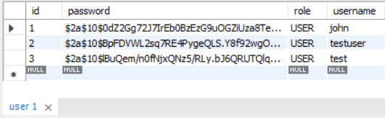
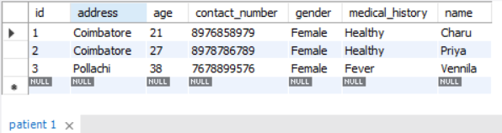
DATABASE SCHEMAS
User table:
Patient table:

Slide 23
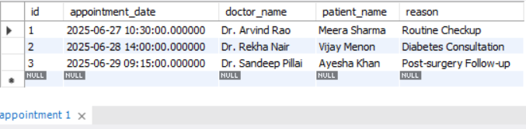
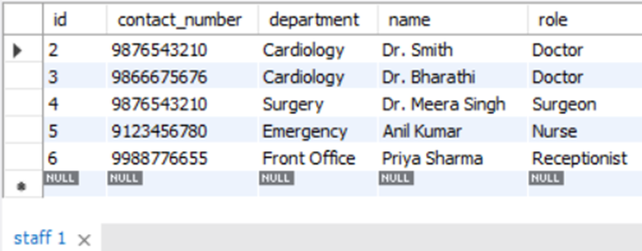
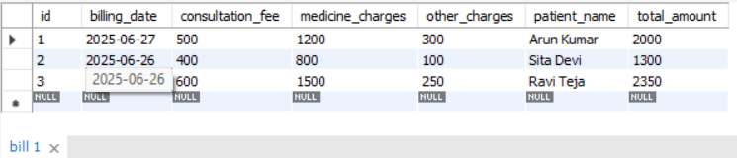
Appointment table:
Staff table:
Billing table:

